Slide 1
FILE SYSTEMS

Slide 2
File Systems
File organization
Access methods
Directory Organization: single, two-level, hierarchy
File system and directory implementation
Allocation schemes : contiguous, linked, indexed

Slide 3
File system
In a computer, a file system (sometimes written filesystem) is the way in which files are named and where they are placed logically for storage and retrieval.
The logical unit within a file system is the file
logical files are mapped into physical entities by the OS
in user's view, file is the smallest unit that can be saved to disk
■

Slide 4
A file system defines the structure and the rules used to read, write, and maintain information stored on a disk.
■
■
Which system used is determined by;
Hardware Software Security needs
Need for a dual-booting system
■
■
■

Slide 5
File Attributes
■
name : provides handle for reference
DOS (8 chars + 3 char extension), Windows (unlimited? length)
UNIX (spaces tricky, no extension needed)
■
type : indicates how the file should be treated
DOS/Windows rely on extension, can map extensions to programs
Mac associates creator attribute with each file (OS X?)
UNIX uses "magic number", first few bytes of file specify file type

Slide 6
e.g. MS-DOS filename
■
Filename: 1 to 8 characters
File extension: 1 to 3 characters DOS only uses uppercase
You cannot use spaces
A single period separates the file extension from the filename
You cannot use these characters:
/ \ : * ? “ < > | + = ; , [ ]
■
■
■
■
■

Slide 7
The Full Path
■
What does it mean?
The complete path from the root of the files system to the desired object.
Use \ (vs. /)
C:\ - the root For Example;
E:\BSIT\6th Semester\System Administration\File System.ppt

Slide 8
File Names continued
■
Filenames consist of two parts
Main part of filename
  Identifies the contents of the file File extension
  Identifies the file type
■
■
The last period separates the file extension from the main part of the filename.
Windows typically associates a file extension with an application installed on a computer
■

Slide 9
Folder Names
■
Folder names follow the same guidelines for naming files
■
Folder names usually do not have a file extension

Slide 10
File Operations create : find space on disk and make entry in directory write : write to file, requires positioning within the file read : read from file, involves positioning within the file delete : delete directory entry, reclaim disk space reposition : move read/write position
■
■
■
■
■

Slide 11
the OS must maintain information about all open files
file pointer : the current position of the read/write pointer in the file
disk location : the location of the file on the disk
file open count : keep track of number of processes currently accessing the file
■
■
such a table of information allows the OS to enforce policies such as only one process can write to a file at a given time

Slide 12
File Structure
files can be stored physically as
Bytes
Lines
records
whatever entity is stored, OS must map into a disk sector
because on a physical disk, sectors are smallest writeable unit

Slide 13
FAT???
file allocation table – where the OS records how the disk space is used
locates the file allocation table near the beginning of the volume
the location of the FAT is specified in the boot sector (BIOS Parameter Block)
actually, 2 copies of the FAT are stored for redundancy
the FAT number refers to the number of bits per table entry
■
■
■
■

Slide 14
File Systems
FAT12: The earliest version the file system, FAT12 allows a partition to contain up to 4096MB/ (212)clusters.
FAT 16: oldest, created for DOS, supported by most OS’s, cannot be installed on partitions larger than 2 GB, or on hard drives larger than 4GB.
FAT 32: supports disks from 512MB to 2TB, compatible with Windows 98 and up

Slide 15
Advantages of FAT File System
■
The FAT file system is best for drives and/or partitions under approximately 200 MB
■
It is better to format system partition as FAT

Slide 16
Disadvantage of FAT File System
It is not better to use FAT on partitions that are greater than 200 megabytes. FAT partitions are limited in size to a maximum of 4 Gigabytes (GB) under Windows NT and 2 GB in MS-DOS.
Any FAT partitions that use DOS-based disk compression (such as DriveSpace) will not have readable files when running Windows NT
■
■
■
The FAT file system is also prone to fragmentation
.

Slide 17
NTFS
New technology file system
Better file security (Encrypting File System),
Disk compression- can compress a file/folder, any Windows app will automatically expand as needed
Disk Quota features- Can enforce quotas on disk usage

Slide 18
Advantages of NTFS
Large disks and large files: NTFS is best for use on volumes of about 400 MB or more
Recoverability: The recoverability designed into NTFS is such that a user should never have to run any sort of disk repair utility on an NTFS partition.
Security: NTFS uses the Windows NT object model to enforce security. An open file is implemented as a file object with a security descriptor that defines its security attributes.

Slide 19
Disadvantages of NTFS
It is not recommended to use NTFS on a volume that is smaller than approximately 400 MB
Currently, there is no file encryption built into NTFS – encryption is available as an external option .
It is not possible to format a floppy disk with the NTFS file system
■
■
■

Slide 20
File Systems
The operating system keeps track of data (documents, pictures, etc.) by placing it into a file.
To store and retrieve files: Disk divided into tracks
Tracks are divided into sectors Sectors grouped into clusters
Number of sectors in a cluster is determined by Size of the hard drive
File allocation system – FAT, FAT32, NTFS

Slide 21
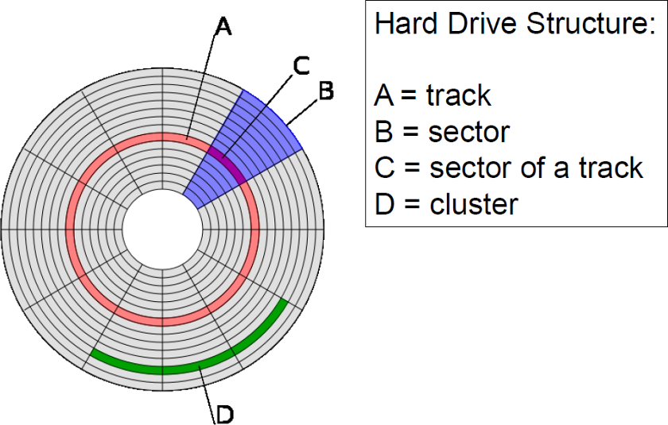

Slide 22
Clusters?
■
A cluster, also known as an allocation unit, consists of one or more sectors of storage space, and represents the minimum amount of space that an operating system allocates when saving the contents of a file to a disk.
The number of sectors per cluster is dependent on
■
Type of disk (floppy disk, hard disk) Version of operating systems
Size of disk
■
■
■
Every sector contains 512 bytes. (NTFS does allow you to change this number.)
The number of clusters per disk is determined by the filing system (FAT 16, FAT 32 or NTFS).
■

Slide 23
DRIVE SIZE | FAT 16 Cluster Size | FAT 32 Cluster Size | NTFS Cluster Size
260 to 511 MB | 8 KB | Not Supported | 512 bytes
512 to 1023 MB | 16 KB | 4 KB | 1KB
1024 MB to 2 GB | 32 KB | 4 KB | 2 KB
2 to 4 GB | 64 KB | 4 KB | 4 KB
4 to 8 GB | Not Supported | 4 KB | 4 KB
8 to 16 GB | Not Supported | 8 KB | 4 KB
16 to 32 GB | Not Supported | 16 KB | 4 KB
>32 GB (up to 2 TB) | Not Supported | 32 KB | 4 KB

Slide 24
OS and File System Compatibility
Operating System | FAT16 | FAT32 | NTFS
Windows XP | ☑ | ☑ | ☑
Windows 2000 | ☑ | ☑ | ☑
Windows NT | ☑ |  | ☑
Windows 95, 98, ME | ☑ | ☑
Windows 95 | ☑
MS-DOS | ☑

Slide 25
Compare FAT and NTFS File System
Compatibility
Only Windows NT supports NTFS partitions , Windows NT and Windows 95 supports both NTFS and FAT
Volume size
FAT supports partition sizes only up to 2 GB , the maximum size of an NTFS partition is 16 EB

Slide 26
Fault tolerance
Windows NT offers software support for several alternate disk-access methods that increase speed and/or fault tolerance, While FAT does maintain two copies of the file-allocation table, in case one copy is damaged, it’s incapable of automatically fixing errors)
File compression
NTFS has its native support for file compression, It offers you the chance to compress individual files and directories of your choice

Slide 27
Security
NTFS has a built-in security system , FAT has no local protection, it only has the share permission (protect the file from network

Slide 28
UNIX File System
Unix file system is a logical method of organizing and storing large amounts of information
A file is a smallest unit in which the information is stored.
All files are organized into directories.
Files in Unix System are organized into multi-level hierarchy structure known as a directory tree.
At the very top of the file system is a directory called “root” which is represented by a “/”.
All other files are “descendants” of root.

Slide 29
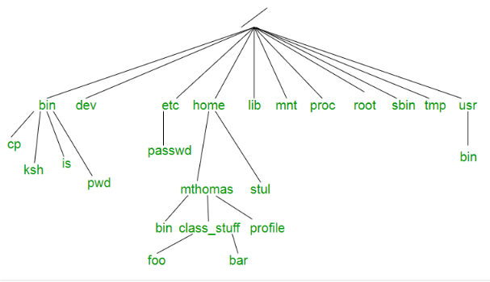

Slide 30
Directories or Files and their description
/ : The slash / character alone denotes the root of the filesystem tree.
/bin : Stands for “binaries” and contains certain fundamental utilities
/boot : Contains all the files that are required for successful booting process.
/dev : Stands for “devices”. Contains file representations of peripheral devices and pseudo-devices.
/etc : Contains system-wide configuration files and system databases.
/home : Contains the home directories for the users.

Slide 31
/lib : Contains system libraries, and some critical files such as kernel modules or device drivers.
/media : Default mount point for removable devices, such as USB sticks, media players, etc.
/mnt : Stands for “mount”. Contains filesystem mount points.
/root : The home directory for the superuser “root” – that is, the system administrator.
/tmp : A place for temporary files.
/usr : Originally the directory holding user home directories,its use has changed. It now holds executables, libraries, and shared resources that are not system critical, /usr/bin : This directory stores all binary programs distributed with the operating system not residing in /bin, /sbin or (rarely) /etc.

Slide 32
/usr/include : Stores the development headers
/usr/lib : Stores the required libraries and data files for programs stored within /usr or elsewhere.
/var : A short for “variable.” A place for files that may change often – especially in size,
/var/mail : The place where all the incoming mails are stored.
/var/spool : Spool directory. Contains print jobs, mail spools and other queued tasks.
/var/tmp : A place for temporary files which should be preserved between system reboots.

Slide 33
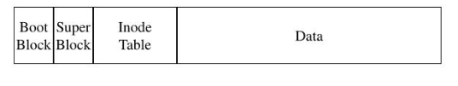
Old file System Layout

Slide 34
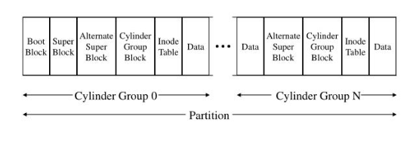
UNIX File System Layout

Slide 35
UFS Block Types
• Bootblocks : Information used when booting the system
• Superblocks : Detailed information about the file system
• Inodes : All information about a file system
• Data blocks : Data for each file
• Cylinder group information: Made up of one or more consecutive disk cylinder

Slide 36
Boot Block
The boot block stores the procedures used in booting the system.
If a file system is not to be used for booting, the boot block is left blank.
The boot block appears only in the first cylinder group (cylinder group 0) and is the first 8 Kbytes in a slice.

Slide 37
The Superblock
The superblock stores much of the information about the file system.
Size and status, Label, Date and time of the last update, Cylinder group size, Number of data blocks in a cylinder group, Summary data block, File system state: clean, stable, or active, Path name of the last mount point
The superblock is located at the beginning of the disk slice, and is replicated in each cylinder group.
Because the superblock contains critical data, multiple superblocks are made when the file system is created.
A summary information block is kept with the superblock.

Slide 38
Inode
An inode contains all the information about a file except its name, which is kept in a directory.
An inode is 128 bytes. The inode information is kept in the cylinder information block,
    The mode of the file (the set of read-write-execute permissions)
    The number of hard links to the file
    The user ID of the owner of the file
    The group ID to which the file belongs
    The number of bytes in the file
    The date and time the file was last accessed
    The date and time the file was last modified
    The date and time the file was created

Slide 39
Data blocks
The rest of the space allocated to the file system is occupied by data blocks, also called storage blocks.
The size of these data blocks is determined at the time a file system is created.
Data blocks are allocated, by default, in two sizes: an 8-Kbyte logical block size, and a 1-Kbyte fragmentation size.
For a regular file, the data blocks contain the contents of the file.
For a directory, the data blocks contain entries that give the inode number and the file name of the files in the directory.

Slide 40
Free Blocks
Blocks not currently being used as inodes, as indirect address blocks, or as storage blocks are marked as free in the cylinder group map.

Slide 41
Network File System
A Network File System (NFS) allows remote hosts to mount file systems over a network and interact with those file systems as though they are mounted locally.
This enables system administrators to consolidate resources onto centralized servers on the network.

Slide 42
HOW NFS WORKS
TCP is the default transport protocol for NFS version 2 and 3 under Red Hat Enterprise Linux.
UDP can be used for compatibility purposes as needed, but is not recommended for wide usage.
NFSv4 requires TCP.
After TCP wrappers grant access to the client, the NFS server refers to the /etc/exports configuration file to determine whether the client is allowed to access any exported file systems.
Once verified, all file and directory operations are available to the user.

Slide 43
NFS CLIENT CONFIGURATION
The mount command mounts NFS shares on the client side. Its format is as follows:
# mount -t nfs -o options host:/remote/export /local/directory

Slide 44
This command uses the following variables:
options
A comma-delimited list of mount options;
  “Common NFS Mount Options” for details on valid NFS mount options.
server
The hostname, IP address, or fully qualified domain name of the server exporting the file system you wish to mount
/remote/export
The file system or directory being exported from the server, that is, the directory you wish to mount
/local/directory
The client location where /remote/export is mounted

Slide 45
COMMON NFS MOUNT OPTIONS
Beyond mounting a file system with NFS on a remote host, it is also possible to specify other options at mount time to make the mounted share easier to use.
These options can be used with manual mount commands, /etc/fstab settings, and autofs
The following are options commonly used for NFS mounts: intr
Allows NFS requests to be interrupted if the server goes down or cannot be reached.

Slide 46
Starting and Stopping NFS
To run an NFS server, the rpcbind
[1] service must be running. To verify that rpcbind is active, use the
following command:
# service rpcbind status
If the rpcbind service is running, then the nfs service can be started. To start an NFS server, use the following command:
# service nfs start

Slide 47
nfslock must also be started for both the NFS client and server to function properly. To start NFS locking, use the following command:
# service nfslock start
If NFS is set to start at boot, ensure that nfslock also starts by running
chkconfig --listnfslock.
If nfslock is not set to on, this implies that you will need to manually run the service
nfslock start each time the computer starts. To set nfslock to automatically start on boot use
chkconfig nfslock on.

Slide 48
The Network Information Service (NIS) and Network File System (NFS) are services that allow you to build distributed computing systems that are both consistent in their appearance and transparent in the way files and data are shared.

Slide 49
The Network File System (NFS) is a distributed filesystem that provides transparent access to remote disks.
NFS is also built on the RPC protocol and imposes a client-server relationship on the hosts that use it.
An NFS server is a host that owns one or more filesystems and makes them available on the network; NFS clients mount filesystems from one or more servers.
This follows the normal client-server model where the server owns a resource that is used by the client.
In the case of NFS, the resource is a physical disk drive that is shared by all clients

